Slide 1
Reaching Families of Second Language Learners
Presenter:
Rebecca A. Palacios, Ph.D.
National Board Certified Teacher

Slide 2
Use one-on-one communication
Before and After school small discussions
Welcome attitude
Provide opportunities for families to share their experiences via:
Classroom sharing
Posterboards
Family Nights (or after school for 45 min-1 hour)

Slide 3
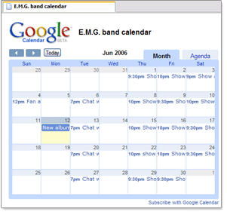
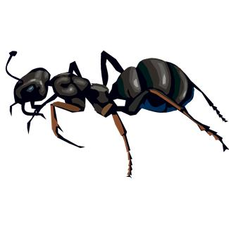
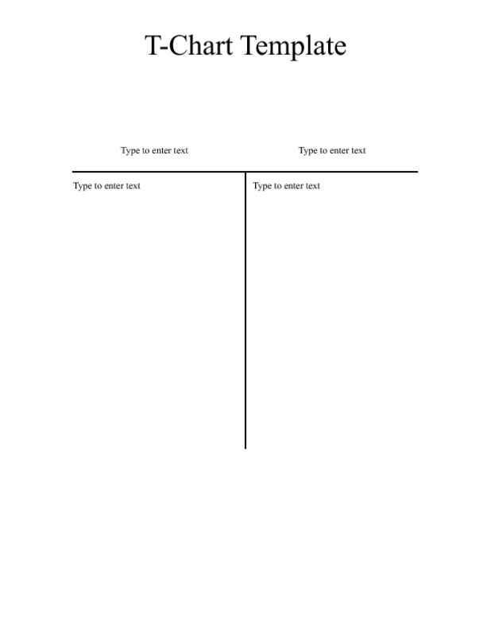
Using pictorial clues
Place clip art pictures on messages, especially children’s vocabulary words
Use simple vocabulary on notes going home and graphic organizers like calendars, clocks, charts, graphs to make text easier.
ant/hormiga
fly/mosca
butterfly/mariposa

Slide 4
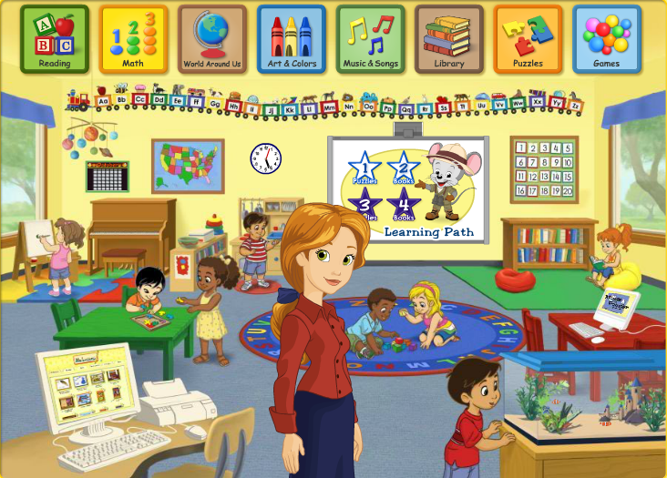
ABCmouse.com

Slide 5
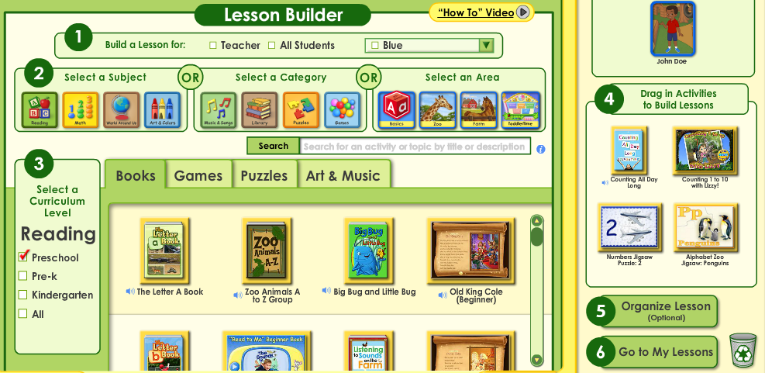
ABCmouse.com

Slide 6
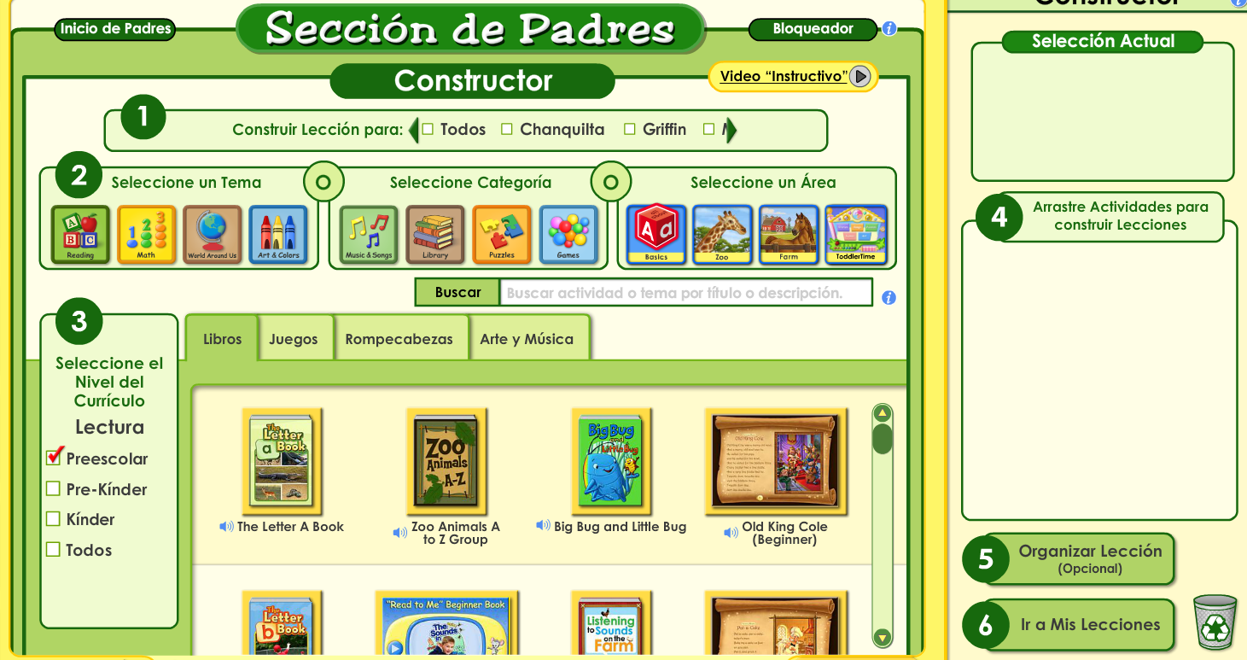
www. abcmouse.com with directions in Spanish

